Slide 1



CAUSAL MEDIATION ANALYSIS
[Restricted] For workshop participants only, not for distribution.
Sharon Tan (Dr)
Faculty of Dentistry, Oral & Craniofacial Sciences, King’s College London, United Kingdom Saw Swee Hock School of Public Health, National University of Singapore, Singapore Faculty of Dentistry, National University of Singapore, Singapore

Slide 2
disclosure
[Restricted] For workshop participants only, not for distribution.
I declare no conflict of interest
Notes:
Snijders and bokers 20
Median odds ratio merlo 2006

Slide 3
Case study - BACKGROUND
[Restricted] For workshop participants only, not for distribution.
Oral disease burden among persons from different income groups influenced by
Diet
Dental care utilisation
Oral hygiene practices
etc.
Studies suggest sugar consumption is associated with higher risk of dental caries (as measured by DMFT) (Moores et al, 2022)
Moores, C. J., Kelly, S. A. M., & Moynihan, P. J. (2022). Systematic Review of the Effect on Caries of Sugars Intake: Ten-Year Update. Journal of dental research, 101(9), 1034–1045. https://doi.org/10.1177/00220345221082918

Slide 4
Case study - Aim
[Restricted] For workshop participants only, not for distribution.
To assess the influence of socioeconomic status (income) and sugar consumption on dental caries

Slide 5
Case study - Aim
[Restricted] For workshop participants only, not for distribution.
Income
Dental caries (DMFT)
DMFT is higher in those with lower income (Schwendicke et al 2015)
Schwendicke, F., Dörfer, C. E., Schlattmann, P., Foster Page, L., Thomson, W. M., & Paris, S. (2015). Socioeconomic inequality and caries: a systematic review and meta-analysis. Journal of dental research, 94(1), 10–18. https://doi.org/10.1177/0022034514557546

Slide 6
Case study - Aim
[Restricted] For workshop participants only, not for distribution.
Income
Dental caries (DMFT)
?
Sugar consumption
?
?
Potential outcomes framework (Holland 1986, Rubin 2005)
Y_{i}(1) – Y_{i}(0), but one outcome will not be observed
Causal treatment effect estimated at average level
Holland, P. W. (1986). Statistics and causal inference. Journal of the American statistical Association, 81(396), 945-960.
Rubin, D. B. (2005). Causal inference using potential outcomes: Design, modeling, decisions. Journal of the American statistical Association
Notes:
But what if we now consider a third factor, sugar consumption? We know that income is associated with dental caries, but does sugar consumption, that varies based on income status, make a difference?
And how much of the effect goes through this mediated pathway?
Higher income, buy less junk food

Slide 7

WHY CAUSAL MEDIATION?
[Restricted] For workshop participants only, not for distribution.
Goes beyond “does $X$ $(income)$affect $Y ($DMFT)?” to “how does $X$ affect $Y?$”
via mediator $M$ $(sugar consumption)$
Decomposes total effect into:
Indirect effect representing the effect of income on change in dental caries that acts through sugar consumption levels
Direct effect of income (changing from low to high income) on dental caries through other pathways
Notes:
Causal mediation is used when you don’t just want to know whether $X$ affects $Y$, but how and through what pathway the effect happens—specifically, how much of the effect operates through a mediator $M$.
Why use causal mediation (what it gives you)
Mechanism / explanation
It decomposes the total causal effect of $X$ on $Y$ into:
an indirect effect (through $M$)
a direct effect (through other pathways)
This answers questions like: “Is the intervention working because it changes $M$, or despite $M$?”
Better intervention design
If most of the effect is mediated by $M$, you can strengthen the program components that move $M$.
If the mediated effect is small, then targeting $M$ may not improve outcomes much, and you might focus on other levers.
Policy targeting and resource allocation
Helps decide where to invest: change $X$ broadly, or implement a more targeted strategy that acts on $M$.
Example: If the effect of education on health is largely through income, policies that raise income might substitute for (or complement) educational policies.
Understanding heterogeneous effects / unintended pathways
You may find the “direct” pathway is harmful or beneficial even if the total effect is neutral.
Example: a drug lowers disease via biomarker $M$ but increases side effects via other pathways.
Separates causal mechanism from mere association
Many “mediation” analyses are just regression associations. Causal mediation explicitly states the causal estimands and the assumptions needed to interpret them causally, especially around mediator–outcome confounding.
Why “causal” (and not just “mediation”)
Because decomposing effects into “through $M$” vs “not through $M$” is not identifiable from correlations alone. You need:
a clear causal model (often a DAG),
appropriate adjustment for confounders,
and careful handling of post-treatment variables.
Without this, the “indirect effect” can be badly biased (e.g., if something unmeasured affects both $M$ and $Y$).
When it’s most appropriate
You have a credible causal effect of $X$ on $Y$ (e.g., randomized $X$, or strong observational design).
You have a well-motivated mediator $M$ measured after $X$ and before $Y$.
You can argue that confounding of $M→Y$ is controlled (the hardest part).
If you share your concrete $X$, $M$, and $Y$ (and whether $X$ is randomized), I can explain what causal mediation would answer in your case and what assumptions you’d need.
(esp. confounding of $M→Y$)

Slide 8

WHY CAUSAL MEDIATION?
[Restricted] For workshop participants only, not for distribution.
Helps identify mechanisms and improve intervention design, by targeting the pathway that drives impact
Supports policy/resource decisions
Act on $X (e.g. increase wages)$ vs act on $M$ (e.g. educational efforts to reduce sugar consumption)
Separate causation from mere causation by requiring clear causal assumptions
Notes:
Indirect effect representing the change in DMFT if distribution of sugar consumption is set to that among high income group
Plausible interaction between income and sugar consumption → Effect of sugar consumption on caries differs based on income group

Slide 9
WHAT WILL BE COVERED?
[Restricted] For workshop participants only, not for distribution.
1. Key terminology in causal mediation
2. Potential outcomes framework
3. Decomposing and interpreting direct, indirect and total effects
4. Assumptions and data considerations
5. Real-life applications
Notes:
Explain the purpose of causal mediation analysis and how it helps identify mechanisms through which interventions affect outcomes.
Define key terms in causal mediation (mediator, exposure/treatment, outcome, confounders).
Apply the potential outcomes framework to mediation.
Decompose effects into total, direct, and indirect effects, and correctly interpret these quantities (e.g., natural direct/indirect effects or controlled direct effects, as appropriate).
State and assess core assumptions for causal mediation (e.g., consistency, positivity, no unmeasured confounding for treatment–outcome, treatment–mediator, and mediator–outcome relations; and any required cross-world assumptions) and describe implications of violations.
Identify data and design requirements for mediation analyses (measurement timing, confounder measurement, mediator/outcome measurement quality, sample size considerations).
Conduct a basic causal mediation assessment using simulated data, including fitting the required models, estimating direct/indirect effects, and summarising results.
Interpret mediation outputs in the context of evidence and equity, including how mechanisms may differ across groups, what “effective and equitable” might mean in mediation terms, and how results can inform intervention refinement.

Slide 10
CAUSAL MEDIATION ANALYSIS
[Restricted] For workshop participants only, not for distribution.
Sharon Tan (Dr)
Faculty of Dentistry, Oral & Craniofacial Sciences, King’s College London, United Kingdom Saw Swee Hock School of Public Health, National University of Singapore, Singapore Faculty of Dentistry, National University of Singapore, Singapore

Slide 11
Case study - Aim
[Restricted] For workshop participants only, not for distribution.
Income
Dental caries (DMFT)
?
Sugar consumption
?
?
Notes:
But what if we now consider a third factor, sugar consumption? We know that income is associated with dental caries, but does sugar consumption, that varies based on income status, make a difference?
And how much of the effect goes through this mediated pathway?
Higher income, buy less junk food

Slide 12
STATISTICAL ANALYSIS
[Restricted] For workshop participants only, not for distribution.
Linear regression
Estimations of average causal mediation effects and average direct effects carried out in R
mediation
1000 simulations, yreg – loglinear, nreg - logistic
Notes:
yreg(string) - this specifies the form of regression model to be fitted for the outcome variable. This can be either linear, logistic, loglinear,
Poisson or Negative binomial.
mreg(string) - this specifies the form of regression model to be fitted for the mediator variable. This can be either linear or logistic.
robust (modified) Poisson regression models
Generalized linear model regression with binomial distribution and log-link used instead of logistic regression (RR instead of OR)

Slide 13
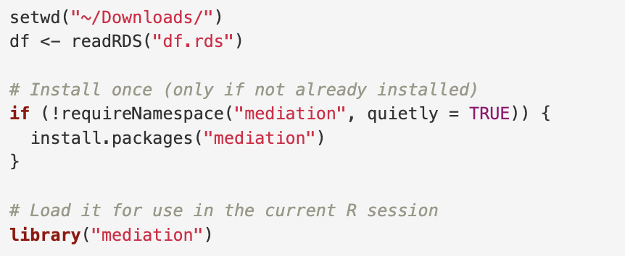
LOAD DATA
[Restricted] For workshop participants only, not for distribution.
Notes:
But what if we now consider a third factor, sugar consumption? We know that income is associated with dental caries, but does sugar consumption, that varies based on income status, make a difference?
And how much of the effect goes through this mediated pathway?
Higher income, buy less junk food

Slide 14
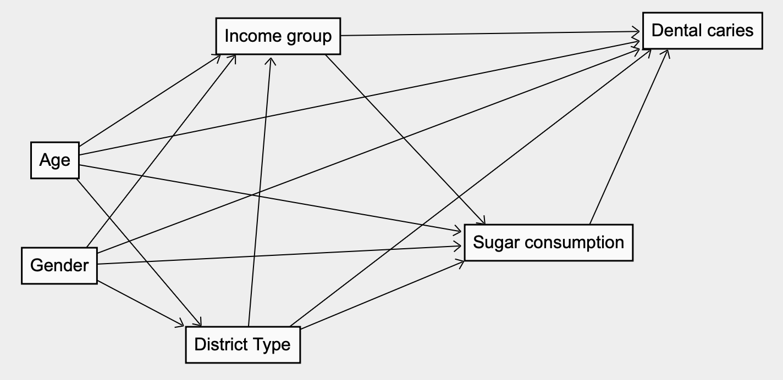
Directed acyclic graph
[Restricted] For workshop participants only, not for distribution.
Notes:
But what if we now consider a third factor, sugar consumption? We know that income is associated with dental caries, but does sugar consumption, that varies based on income status, make a difference?
And how much of the effect goes through this mediated pathway?
Higher income, buy less junk food

Slide 15
[Restricted] For workshop participants only, not for distribution.
EXPOSURE | MEDIATOR | COVARIATES | OUTCOME
Income a=0 Low gross monthly household income a=1 High gross monthly household income | Sugar consumption (grams, continuous) | X -> Y/ X -> M/ M -> Y confounders Gender (male/female) Age (continuous) District Type (public/private) | DMFT (continuous) Caries (yes/no)
Notes:
Threshold of $4000 set based on sample distribution; approximate household income of bottom quartile ($1141-1609 per capita in 2020 * 3.2) in society
https://www.singstat.gov.sg/-/media/files/publications/households/pp-s27.pdf
Additional covariates – factors that affect exposure, mediators and/or outcome
Collected data on age, gender – will affect exposure (household income) and/or mediator (sugar consumption)
Alternative
Caries status Y1 = Caries Y0 = No dental caries
Outcome binary, not rare

Slide 16
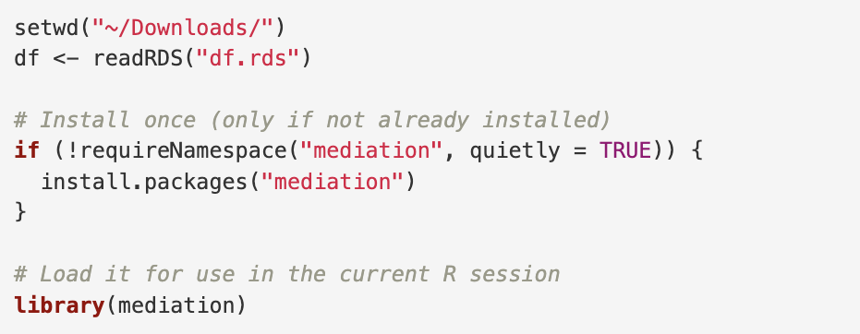
RUN MEDIATION PACKAGE
[Restricted] For workshop participants only, not for distribution.
Notes:
But what if we now consider a third factor, sugar consumption? We know that income is associated with dental caries, but does sugar consumption, that varies based on income status, make a difference?
And how much of the effect goes through this mediated pathway?
Higher income, buy less junk food

Slide 17
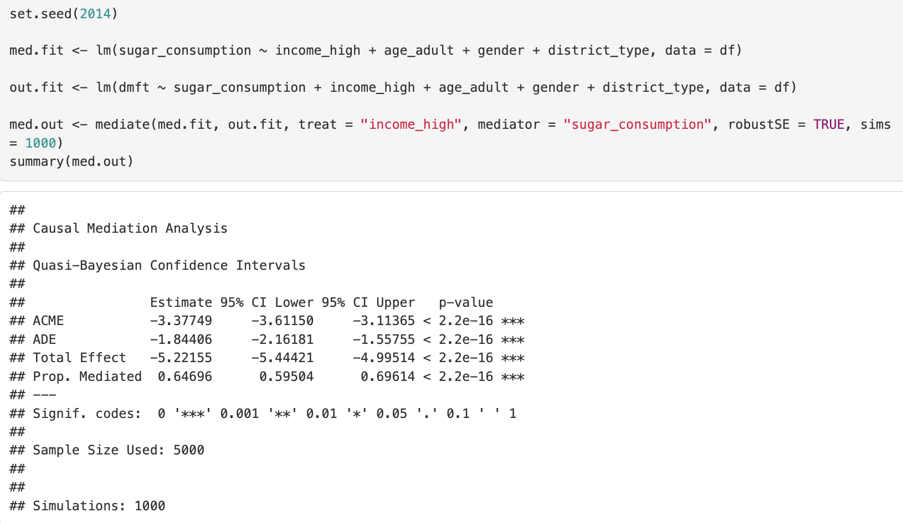
[Restricted] For workshop participants only, not for distribution.
Mediation (continuous outcome)
Linear regression
Robust standard error: White’s heteroskedasticity-consistent estimator for covariance matrix
1000 simulations (quasi-Bayesian Monte Carlo method based on normal approximation)
Notes:
While controlled direct effects are often of greater interest in policy evaluation (Pearl, 2001; Robins, 2003), natural direct and indirect effects may be of greater interest in evaluating the action of various mechanisms (Joffe, Small, & Hsu, 2007; Robins, 2003) total effect is equal to the sum of the natural direct effect and the natural indirect effect when the outcome is continuous and to the product of the natural direct and indirect effect odds ratios when the outcome is binary (i.e. natural direct effect + natural indirect effect (continuous outcome); natural direct*natural indirect effect odds ratios (binary outcome))

Slide 18
Mediation (continuous outcome)
[Restricted] For workshop participants only, not for distribution.
Average causal mediation effect (Indirect effect) through sugar consumption was reduction in DMFT of – 3.4.
Moving from low to high income, direct effect was reduction in DMFT of -1.8.
Total effect = Direct + Indirect effect
Percentage mediated = 65%
Sugar consumption explained 65% of the effect of income on DMFT
Notes:
While controlled direct effects are often of greater interest in policy evaluation (Pearl, 2001; Robins, 2003), natural direct and indirect effects may be of greater interest in evaluating the action of various mechanisms (Joffe, Small, & Hsu, 2007; Robins, 2003) total effect is equal to the sum of the natural direct effect and the natural indirect effect when the outcome is continuous and to the product of the natural direct and indirect effect odds ratios when the outcome is binary (i.e. natural direct effect + natural indirect effect (continuous outcome); natural direct*natural indirect effect odds ratios (binary outcome))

Slide 19
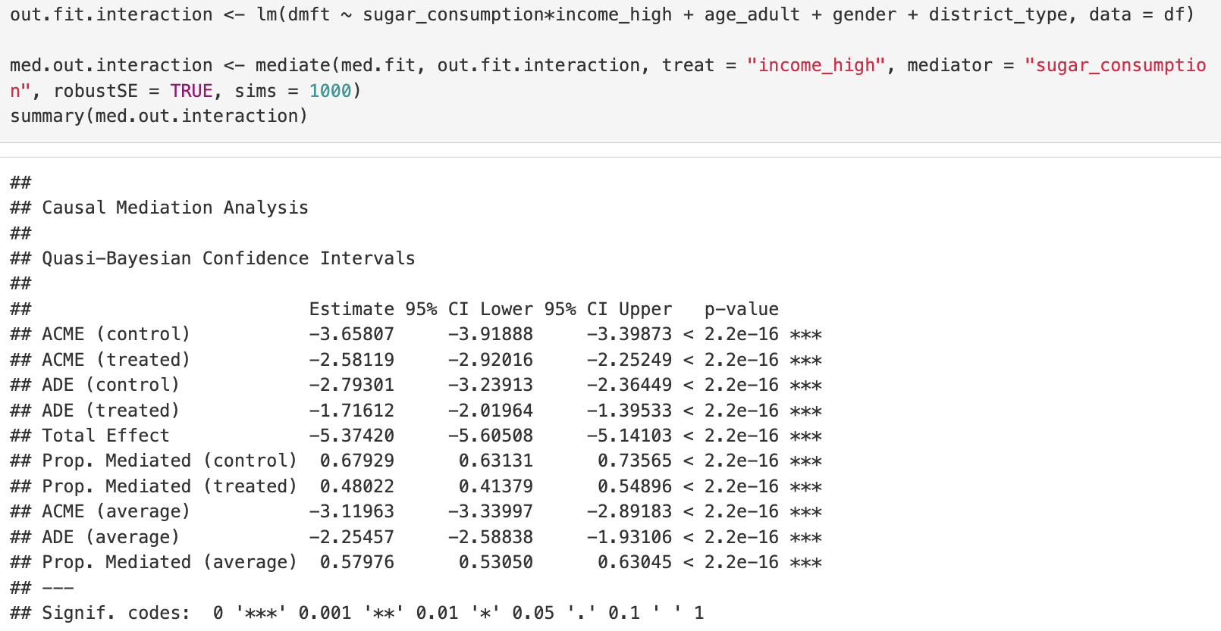
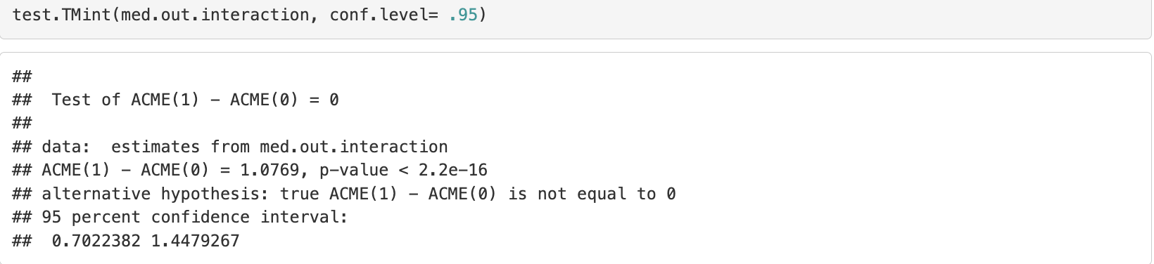
Treatment-mediator interaction
[Restricted] For workshop participants only, not for distribution.
Mediation effect differs by baseline income group!
Treatment-mediator interaction exists
Notes:
While controlled direct effects are often of greater interest in policy evaluation (Pearl, 2001; Robins, 2003), natural direct and indirect effects may be of greater interest in evaluating the action of various mechanisms (Joffe, Small, & Hsu, 2007; Robins, 2003) total effect is equal to the sum of the natural direct effect and the natural indirect effect when the outcome is continuous and to the product of the natural direct and indirect effect odds ratios when the outcome is binary (i.e. natural direct effect + natural indirect effect (continuous outcome); natural direct*natural indirect effect odds ratios (binary outcome))

Slide 20
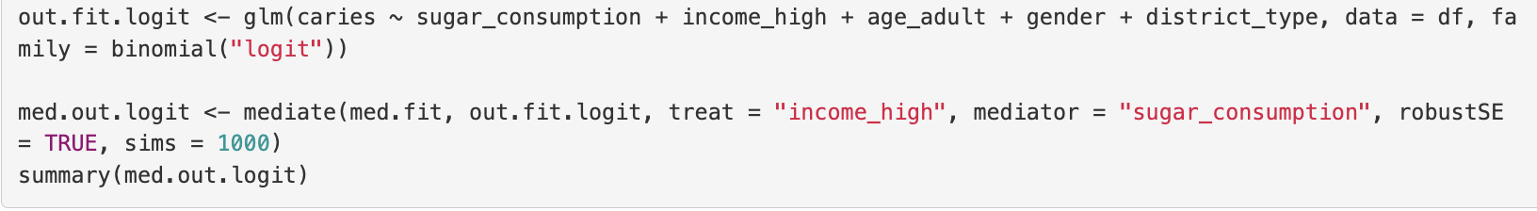
[Restricted] For workshop participants only, not for distribution.
Mediation (binary outcome)
Logistic regression
Intervention (High income)
Control (Low income)
Notes:
While controlled direct effects are often of greater interest in policy evaluation (Pearl, 2001; Robins, 2003), natural direct and indirect effects may be of greater interest in evaluating the action of various mechanisms (Joffe, Small, & Hsu, 2007; Robins, 2003) total effect is equal to the sum of the natural direct effect and the natural indirect effect when the outcome is continuous and to the product of the natural direct and indirect effect odds ratios when the outcome is binary (i.e. natural direct effect + natural indirect effect (continuous outcome); natural direct*natural indirect effect odds ratios (binary outcome))

Slide 21
Counterfactual theory
[Restricted] For workshop participants only, not for distribution.
Natural direct effect (NDE) “how much the outcome would change if the exposure were set at level a=1 versus level a*=0 but for each individual the mediator were kept at the level it would have taken in the absence of the exposure”
Natural indirect effect (NIE) “how much the outcome would change on average if the exposure were controlled at level a=1, but the mediator were changed from the level it would take if a*=0 to the level it would take if a=1”
Total effect (TE) “how much the outcome would change overall for a change in the exposure from level a*=0 to level a=1”
Valeri, L., & Vanderweele, T. J. (2013). Mediation analysis allowing for exposure-mediator interactions and causal interpretation: theoretical assumptions and implementation with SAS and SPSS macros. Psychological methods, 18(2), 137–150. https://doi.org/10.1037/a0031034
Notes:
While controlled direct effects are often of greater interest in policy evaluation (Pearl, 2001; Robins, 2003), natural direct and indirect effects may be of greater interest in evaluating the action of various mechanisms (Joffe, Small, & Hsu, 2007; Robins, 2003) total effect is equal to the sum of the natural direct effect and the natural indirect effect when the outcome is continuous and to the product of the natural direct and indirect effect odds ratios when the outcome is binary (i.e. natural direct effect + natural indirect effect (continuous outcome); natural direct*natural indirect effect odds ratios (binary outcome))

Slide 22
Counterfactual theory
[Restricted] For workshop participants only, not for distribution.
Controlled direct effect (CDE) “how much the outcome would change on average if the mediator were controlled at level m uniformly in the population, but the treatment were changed from level a* = 0 to level a =1”
Valeri, L., & Vanderweele, T. J. (2013). Mediation analysis allowing for exposure-mediator interactions and causal interpretation: theoretical assumptions and implementation with SAS and SPSS macros. Psychological methods, 18(2), 137–150. https://doi.org/10.1037/a0031034
Notes:
While controlled direct effects are often of greater interest in policy evaluation (Pearl, 2001; Robins, 2003), natural direct and indirect effects may be of greater interest in evaluating the action of various mechanisms (Joffe, Small, & Hsu, 2007; Robins, 2003) total effect is equal to the sum of the natural direct effect and the natural indirect effect when the outcome is continuous and to the product of the natural direct and indirect effect odds ratios when the outcome is binary (i.e. natural direct effect + natural indirect effect (continuous outcome); natural direct*natural indirect effect odds ratios (binary outcome))

Slide 23
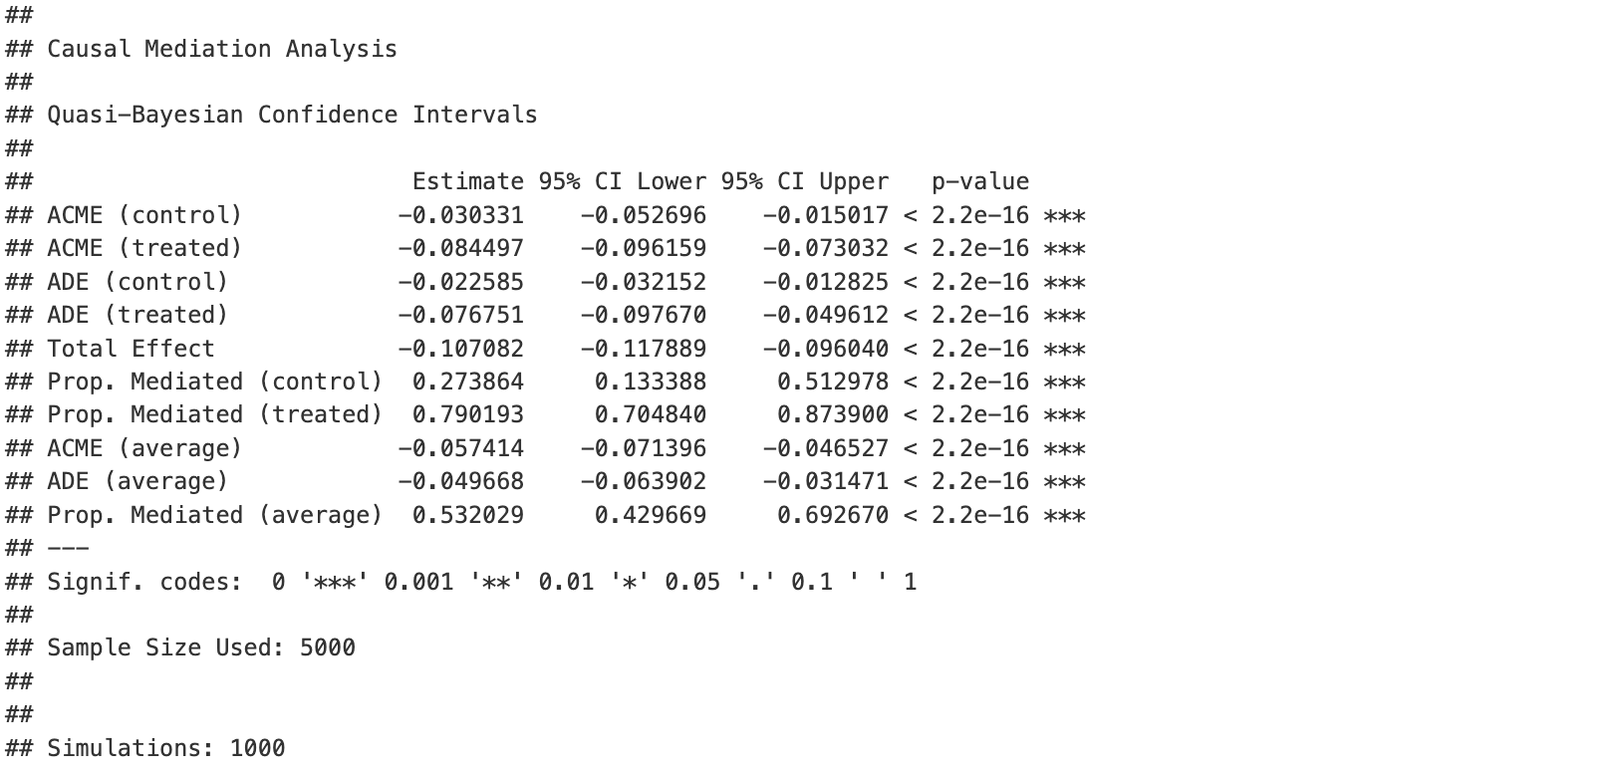


Mediation (binary outcome)
[Restricted] For workshop participants only, not for distribution.
Natural indirect effect (low income): $Y\left\{0, M\left(1\right)\right\} −Y\left\{0, M\left(0\right)\right\}$
$$\text{M}\text{(1): }\text{potential} \text{sugar} \text{consumption} \text{level} \text{for} \text{high} \text{income}\text{, }\text{M}\text{(0): }\text{potential} \text{sugar} \text{level} \text{for} \text{low} \text{income}$$ If we set income as high income, the effect of income on caries prevalence that was solely attributed to changes in sugar consumption was -3.0pp (95% CI = -5.0pp - -1.5pp).
Natural indirect effect (high income): $Y\left\{1, M\left(1\right)\right\} −Y\left\{1, M\left(0\right)\right\}$ If we set income as low income, the effect of income on caries prevalence that was solely attributed to changes in sugar consumption was -2.3pp (95% CI = -9.6pp - -7.3pp).
Natural direct effect (high income): Had participants switched to high income, compared to low income, they would on average have a lower prevalence of caries by 7.7pp (95% CI = 5.0pp - 9.8pp), had sugar consumption levels stayed at the level that would have been observed for high income
Natural direct effect (low income): Had participants switched to high income, compared to low income, they would on average have a lower prevalence of caries by 2.3pp (95% CI = 1.3pp - 3.2pp), had sugar consumption levels stayed at the level that would have been observed for low income
Byeon, S., & Lee, W. (2023). An Introduction to Causal Mediation Analysis With a Comparison of 2 R Packages. Journal of preventive medicine and public health = Yebang Uihakhoe chi, 56(4), 303–311. https://doi.org/10.3961/jpmph.23.189
Notes:
ACME(control) and ACME(treated) They exist because with a binary outcome + logistic regression (and/or treatment–mediator interaction), mediation effects generally depend on the level of the treatment (the decomposition is not unique like it is in simple linear models).
total effect is equal to the sum of the natural direct effect and the natural indirect effect when the outcome is continuous and to the product of the natural direct and indirect effect odds ratios when the outcome is binary (i.e. natural direct effect + natural indirect effect (continuous outcome); natural direct*natural indirect effect odds ratios (binary outcome))
Marginal direct effect

Slide 24
Mediation (binary outcome)
[Restricted] For workshop participants only, not for distribution.
Total effect Y(1) – Y(0)
= ACME (control) + ADE (treated) = ACME (treated) + ADE (control)
Overall, a switch from low to high income resulted in a 10.7pp reduction in prevalence of caries
Proportion of effect mediated through sugar consumption when income is fixed as low income is 27.4%
Proportion of effect mediated through sugar consumption when income is fixed as high income is 79.0%
Midpoint/ average of ACME (control) and ACME (treated)
Overall, sugar consumption explained 53.2% of the effect of income on caries prevalence (midpoint/ average of proportion mediated (control) and proportion mediated (intervention))
Midpoint/ average of ADE (control) and ADE (treated)
Notes:
While controlled direct effects are often of greater interest in policy evaluation (Pearl, 2001; Robins, 2003), natural direct and indirect effects may be of greater interest in evaluating the action of various mechanisms (Joffe, Small, & Hsu, 2007; Robins, 2003) total effect is equal to the sum of the natural direct effect and the natural indirect effect when the outcome is continuous and to the product of the natural direct and indirect effect odds ratios when the outcome is binary (i.e. natural direct effect + natural indirect effect (continuous outcome); natural direct*natural indirect effect odds ratios (binary outcome))
Marginal direct effect

Slide 25
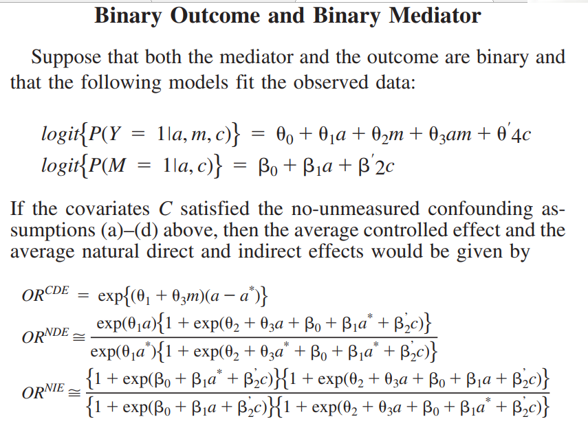
[Restricted] For workshop participants only, not for distribution.
Notes:
Probit

Slide 26
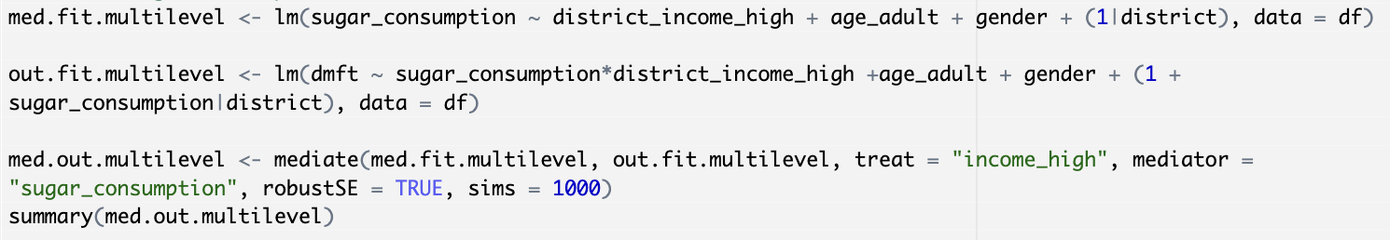
[Restricted] For workshop participants only, not for distribution.
Multilevel (group-level exposure, individual-level mediator)
E.g. area-level income, instead of personal income
Notes:
While controlled direct effects are often of greater interest in policy evaluation (Pearl, 2001; Robins, 2003), natural direct and indirect effects may be of greater interest in evaluating the action of various mechanisms (Joffe, Small, & Hsu, 2007; Robins, 2003) total effect is equal to the sum of the natural direct effect and the natural indirect effect when the outcome is continuous and to the product of the natural direct and indirect effect odds ratios when the outcome is binary (i.e. natural direct effect + natural indirect effect (continuous outcome); natural direct*natural indirect effect odds ratios (binary outcome))

Slide 27
CASUAL INTERPRETATION ASSUMPTIONS
[Restricted] For workshop participants only, not for distribution.
Exchangeability/ Ignorability/ Conditional independence
Identifiability of controlled direct effect
(1) No unmeasured confounding of treatment-outcome relationship
(2) No unmeasured confounding of mediator-outcome relationship
Identifiability of natural direct & indirect effects
(1) + (2) +
(3) No unmeasured confounding of treatment-mediator relationship
(4) No mediator-outcome confounder that is affected by treatment
conditional on pretreatment covariates C
Nguyen, T. Q., Schmid, I., Ogburn, E. L., & Stuart, E. A. (2022). Clarifying causal mediation analysis: Effect identification via three assumptions and five potential outcomes. Journal of causal inference, 10(1), 246–279. https://doi.org/10.1515/jci-2021-0049
Notes:
Treatment randomization satisfies assumptions (1) and (3) only (1) (2) and (3) require assumption of temporal ordering (treatment comes before mediator, treatment come comes before outcome, mediator comes before outcome)
Treatment induced mediator outcome confounding - e.g. income increase dental visits, lower sugar intake, dental visits also reduce dental caries through topical fluoride application

Slide 28
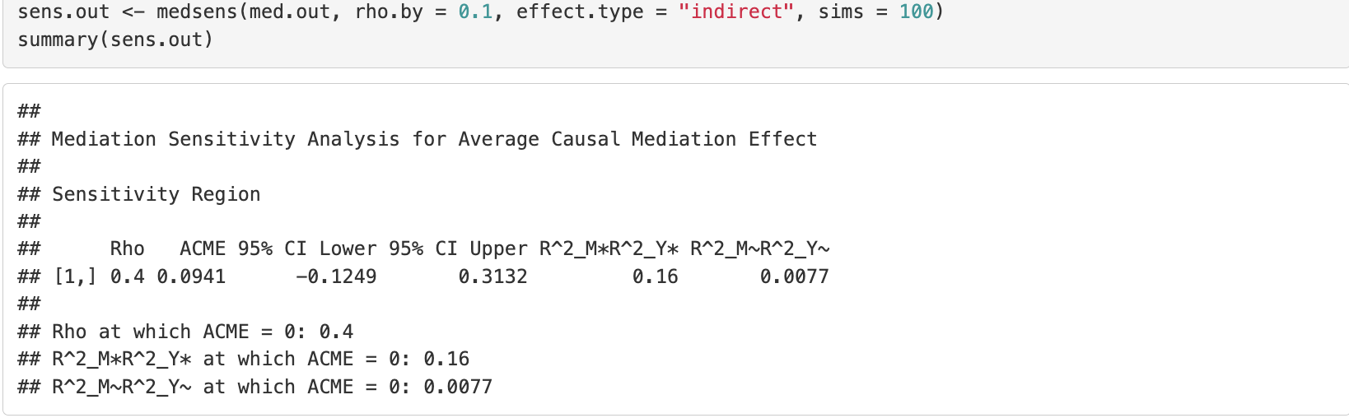
Sensitivity testing for sequential ignorability
[Restricted] For workshop participants only, not for distribution.
Rho will vary from −0.9 to 0.9 by 0.1 increments
Sensitivity test for indirect effect (ACME)
Alternatives: ”direct” (ADE), both
Confidence of ACME includes 0 when rho = 0.4
The higher the R^_2M*R^2_Y value, the more robust the mediation results
The product of proportions of residual variance in the mediator model and outcome models (residual confounding) required to get ACME = 0 is 0.016
The product of proportions of total variance in the mediator model and outcome models required to get ACME = 0 is 0.0077
Notes:
If R2M AND R2Y are equal, square root of 0.016 = 0.126 , about 12.6% of residual variance has to be explained by omitted confounder

Slide 29
OTHER ASSUMPTIONS
[Restricted] For workshop participants only, not for distribution.
Time-independence
Fairly consistent socioeconomic position over time
Prospective studies
Correct temporal order (e.g. X→ M→ Y)
Positivity/ Overlap/ Common support
Non-zero probability of people belonging to high and low income groups given the covariates
Non-zero probability of sugar consumption taking on different values when people switch income groups
Consistency/ SUTVA (stable unit treatment value assumption)
Treatment for low income group (or high income group) does not affect outcome of the other group
Nguyen, T. Q., Schmid, I., Ogburn, E. L., & Stuart, E. A. (2022). Clarifying causal mediation analysis: Effect identification via three assumptions and five potential outcomes. Journal of causal inference, 10(1), 246–279. https://doi.org/10.1515/jci-2021-0049
Notes:
https://sper.org/wp-content/uploads/2019/07/Snowden-Reavis-SPER-Workshop-2019.pdf
Can CHAS uptake be influenced by dental utilization? Perhaps but more likely it’s a result of income status/income group Verify in prospective studies
Causal models require prior research on causal modelling in this field/ prior assumptions/priors (Bayesian/DAGs), currently we are still working on priors, we are starting somewhere Somebody has to do that
Positivity – assume that individuals have option of being included in CHAS group Consistency

Slide 30
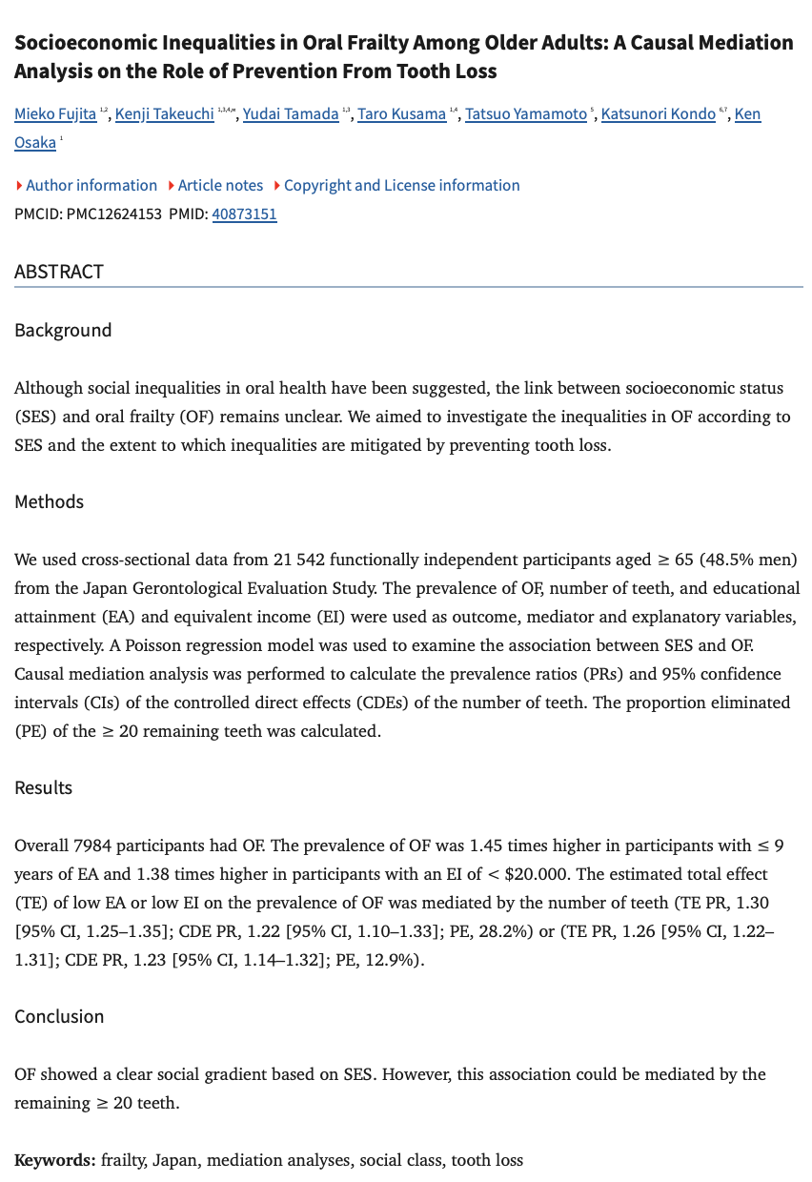
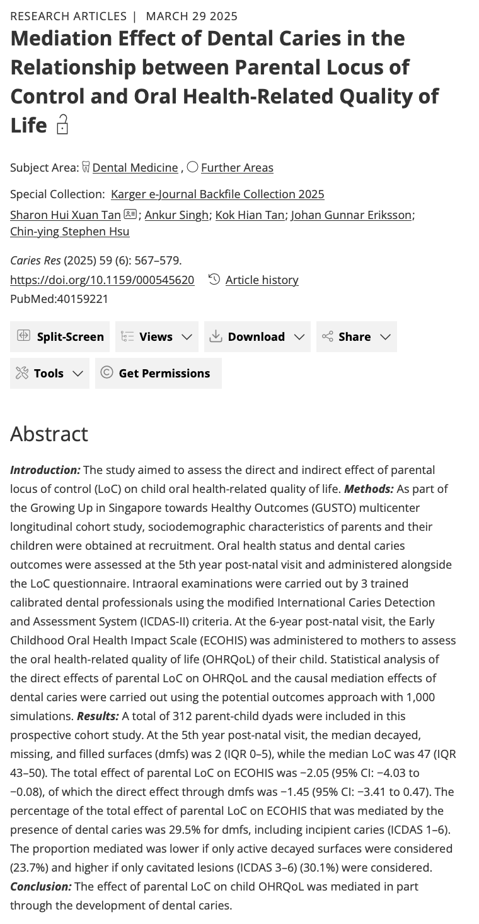
some examples
[Restricted] For workshop participants only, not for distribution.
Notes:
https://sper.org/wp-content/uploads/2019/07/Snowden-Reavis-SPER-Workshop-2019.pdf
Can CHAS uptake be influenced by dental utilization? Perhaps but more likely it’s a result of income status/income group Verify in prospective studies
Causal models require prior research on causal modelling in this field/ prior assumptions/priors (Bayesian/DAGs), currently we are still working on priors, we are starting somewhere Somebody has to do that
Positivity – assume that individuals have option of being included in CHAS group Consistency

Slide 31
Thank you.
[Restricted] For workshop participants only, not for distribution.

Slide 32
Traditional approaches
[Restricted] For workshop participants only, not for distribution.
Path analysis (Structural Equation Modeling)
Problem with SEM: does not adequately address issues of confounding and endogeneity in inferring causal relationships
Product method and difference method differ for binary outcomes
No decomposition property when exposure-mediator interaction term is present
Traditional approach (Baron and Kenny 1986)
No confounders included
For cases where linear regression is used for mediator and outcome
Assume no exposure-mediator interaction
Non-collapsibility of odds ratios (for binary outcomes); non-interpretable estimate
Assumes no unmeasured confounding of mediator-outcome path
Notes:
Assumes linearity in associations Runs all equations together at the same time; does not take into account mediator related confounding Moderated mediation, when covariate moderates mediated effect, indirect and direct effect do not sum up to give total effect (takes into exposure-outcome confounding but not mediator-outcome)
No counterfactual basis [only say mediated by how much]
Baron & Kenny
First, effect decomposition – the fact that the direct and indirect effects sum to the total – using the product or difference method only works in the special case where linear regression is used for the mediator and outcome models and when there is no exposure-mediator interaction. If interaction is present and the traditional approach is utilized, the effect estimates obtained will not be interpretable. One point worth noting about assessing mediation with binary outcomes when the outcome is common is that because of non-collapsibility (failure of the measure when taken on a group to equal a simple average of the measure when taken on the group's members or subgroups) of the odds ratio, the traditional approach to mediation even if there is no X-M interaction will result in a non-interpretable estimate. Specifically, this would give you a conservative test of mediation (see VanderWeele’s textbook for more information).
https://www.publichealth.columbia.edu/research/population-health-methods/causal-mediation#:~:text=When%20a%20mediator%20is%20hypothesized,that%20works%20through%20the%20mediator.

Slide 33
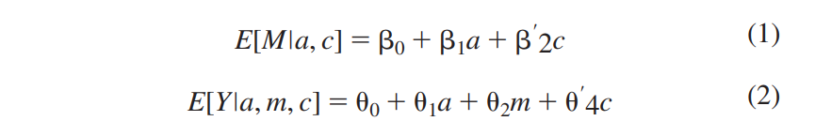
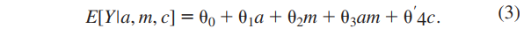
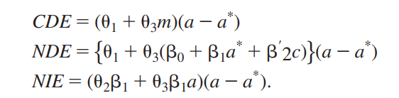
[Restricted] For workshop participants only, not for distribution.
Baron and Kenny (1986) parametric approach to estimate and test for mediation (assume continuous mediator and outcome)
A = treatment [a = exposure at end of study (treatment = 1) a* = exposure at baseline (treatment = 0)]
Y = outcome
M = mediator
C = additional covariates
Extension of Baron and Kenny formulae for direct and indirect effects in counterfactual framework (Robins & Greenland, 1992, Pearl, 2001)
Valeri, L., & Vanderweele, T. J. (2013). Mediation analysis allowing for exposure-mediator interactions and causal interpretation: theoretical assumptions and implementation with SAS and SPSS macros. Psychological methods, 18(2), 137–150. https://doi.org/10.1037/a0031034
Notes:
original Baron and Kenny approach did not have covariates, but the same general approach applies with covariates (i.e., 2c and 4c were not included in the original models by the authors; here c is considered a vector and may contain multiple confounders). In particular, Baron and Kenny proposed that the direct effect be assessed by estimating theta1 and that the indirect effect be assessed by estimating beta1theta2.
Product method (if no exposure-mediator interaction) Difference method (theta1 in equation without mediator – theta1 in equation with mediator; equivalent to result in product method if continuous outcome on difference scale [differs for binary outcome/logistic regression]

Slide 34
Sample size calculation
[Restricted] For workshop participants only, not for distribution.
Qin X. (2024). Sample size and power calculations for causal mediation analysis: A Tutorial and Shiny App. Behavior research methods, 56(3), 1738–1769. https://doi.org/10.3758/s13428-023-02118-0

